Slide 1
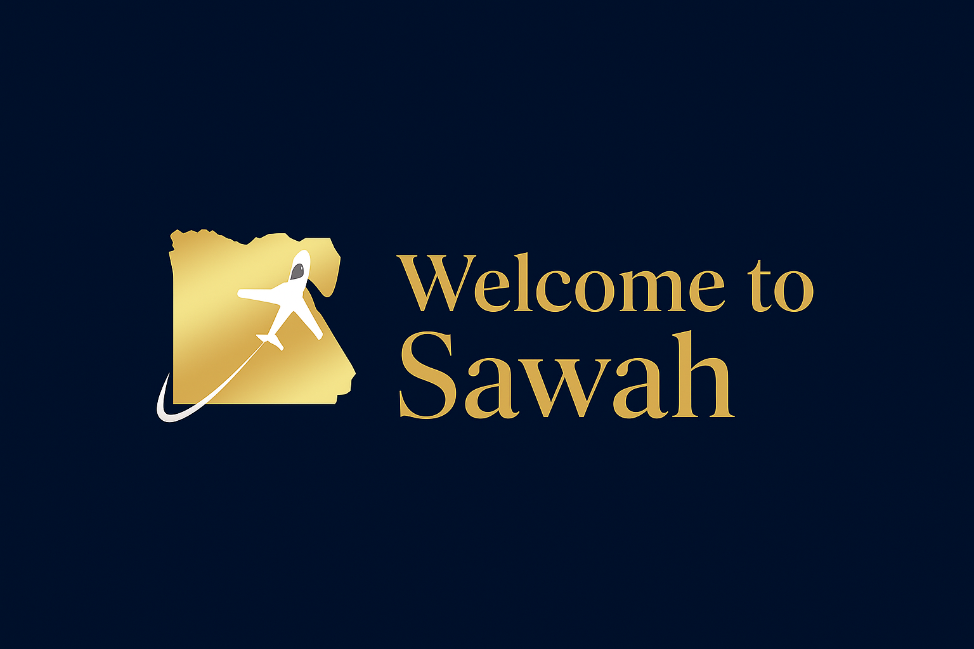






Slide 2
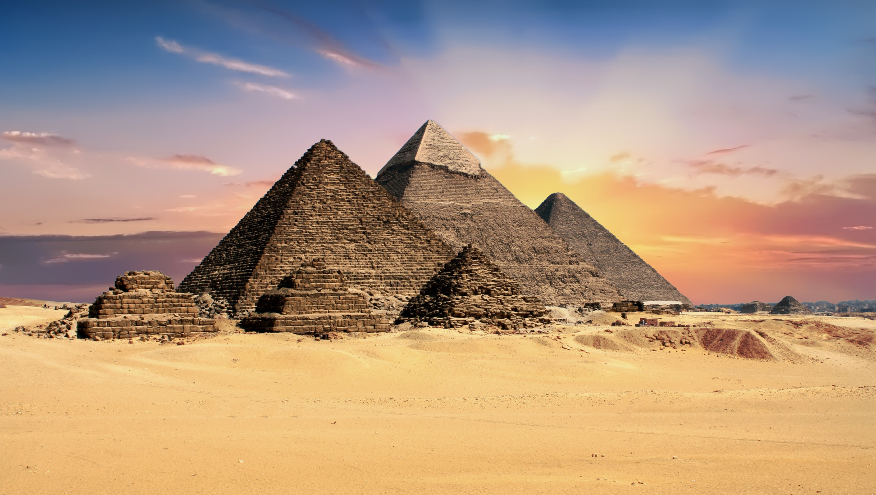
Egypt’s Tourism Context & Why Sawah Matters
Egypt is one of the world’s most iconic travel destinations, attracting millions each year for its history, spirituality, and leisure.
Tourism significantly supports Egypt’s economy, local businesses, and global image.
However, visitors often face hidden costs, tipping pressure, limited digital support, and restricted access to authentic experience

Slide 3



ABOUT SAWAH
SAWAH IS A DIGITAL TOURISM APP REDEFINING THE TRAVEL EXPERIENCE IN EGYPT.
IT OFFERS TRAVELERS:
PERSONALIZED TRIP PLANNING
PRICE TRANSPARENCY & FINANCIAL AWARENESS
AUTHENTIC LOCAL EXPERIENCES & SMART RECOMMENDATIONS
GAMIFIED JOURNEYS WITH HISTORICAL AVATARS
SUPPORT FOR SUSTAINABLE TOURISM & VISITOR RIGHT

Slide 4



PROBLEM STATEMENT (WHY SAWAH IS NEEDED):
LACK OF PERSONALIZATION
HIDDEN COSTS & TIPPING PRESSURE
WEATHER-RELATED CONSTRAINTS
WEAK STORYTELLING INTEGRATION

Slide 5




سواح
WILL SERVE AS A MOBILE APPLICATION / WEBSITE TAILORED TO BOTH INTERNATIONAL TOURISTS AND EGYPTIANS LIVING ABROAD WHO RETURN FOR VISITS, WHILE ALSO EXTENDING VALUE TO DOMESTIC TRAVELERS. ITS SCOPE INCLUDES:

Slide 6




THE SCOPE
TRIP CUSTOMIZATION
FINANCIAL PROTECTION
Clear price lists, awareness of tipping limits, and fair ride estimations to avoid unnecessary expenses
Personalized itineraries based on budget, group size, interests, and trip duration

Slide 7
THE SCOPE
SUSTAINABILITY FEATURES
SMART RECOMMENDATIONS
Guidance on reducing carbon footprints through walking, cycling, or eco-friendly alternatives.
Daily indoor or outdoor suggestions based on real-time weather data

Slide 8
THE SCOPE
ENGAGEMENT TOOLS
LOYALTY PROGRAMS
Gamification via historical avatars and loyalty programs that reward exploration
that build a relationship between customer and the country visited

Slide 9

market research & strategic analysis
1- PRODUCT
2-PRICE
Mobile app lets tourists create their own trips
Covers all main destinations and activities
Fair pricing
Value for money
3-PLACE
4-PROMOTION
Available online with in-app guidance
Accessible globally
App designed to make tourists feel safe
Storytelling features guide tourists .
Focus on reassuring and supporting tourists

Slide 10
market research & strategic analysis
5-PEOPLE
6-PROCESS
Ai- driven trip planning handles all tour arrangement
Tourists don’t need to rely on strangers
Human support available in-app for questions or help
Easy, step-by-step plan creation in the app.
Tourists select trip type, duration, number of people, budget, and activities.
7-PHYSICAL EVIDENCE
INTERACTIVE APP INTERFACE: INTUITIVE, VISUALLY APPEALING
PHOTOS AND VIDEOS OF DESTINATIONS AND PAST TRIPS INCLUDED.
DAILY SCHEDULE TABLE WITH ACTIVITIES, TIMES, AND LOCATIONS.

Slide 11
market research & strategic analysis
1- CUSTOMER VALUE
2-CONVENIENCE
Full trip planning without a tour guide
Personalized itineraries (goal, family size, budget)
Gamified travel with points & levels
Accessible anytime, anywhere
Simple, user-friendly interface
All-in-one solution (stay, transport, activities)
3- COST
4-COMMUNICATION
More affordable than traditional guides
Rewards: discounts, offers, promo codes
Budget-based customization
Smart notifications & suggestions
Social media engagement (points for sharing)
Feedback & reviews system

Slide 12
market research & strategic analysis
5-CREDIBILITY
6- CONSISTENCY
Same quality from arrival to departure
Seamless journey: plan → book → enjoy → reward
Strong, consistent brand experience
AI + real user reviews
Trusted hotel & attraction partners
Verified offers & promotions
7- CONTEXT
FiTS GLOBAL TRENDS: PERSONALIZATION & GAMIFICATION
FILLS GAP: BEYOND BOOKING → FULL EXPERIENCE
RIGHT TIMING FOR EGYPT & MENA TOURISM MARKET

Slide 13

Target
Audience
1-cultural factors
2-Social factors
3-Personal factor
4-Psychological factor

Slide 14

Buyer
PERSONA
PERSONA 1: THE YOUNG EXPLORER
AGE: 22
BUDGET: LOW–MEDIUM
GOALS: ADVENTURE (SAFARI, DIVING, NIGHTLIFE), INSTAGRAM-WORTHY MOMENTS.
PAIN POINTS: NEEDS AFFORDABLE OPTIONS, RELIES HEAVILY ON ONLINE REVIEWS/SOCIAL MEDIA.

Slide 15
Buyer
PERSONA
PERSONA 2: THE FAMILY PLANNER
AGE: 35–45
BUDGET: MEDIUM–HIGH
GOALS: SAFE, FAMILY-FRIENDLY TRIPS (PYRAMIDS, NILE CRUISE, SHARM RESORTS); EASY BOOKING.
PAIN POINTS: SAFETY CONCERNS; ACTIVITIES SUITABLE FOR KIDS.

Slide 16
Buyer
PERSONA
Persona 3: The Solo Female Traveler
Age: 24–32
Budget: Medium
Goals: explore Egypt safely; mix of history, culture, relaxation; authentic experiences.
Pain Points: safety, scams, navigating alone; needs trustworthy guides and clear information.

Slide 17
Action
Plan

Slide 18

Lunch Plan:
Phase 1 : Awarness(teasers, storytelling vedios on social media)
Phase 2: Engagement (user-generated content , reposts , interactive content & influncer collaboration)
Team Roles:
Marketing team : Campaigns & content
Partnerships team: Deals with hotel/ restaurants/attractions
Customer support: Handle user inquires
Timeline:
Monthly content calander
Weekly KPI check
Final report : by the end of two months

Slide 19
CONTROL :
KPIS TO TRACK- AWARENESS KPIS
FOLLOWER GROWTH :50 NEW FOLLOWERS PER PLATFORM (INSTAGRAM, TIKTOK).
ENGAGEMENT RATE : 50 LIKES, COMMENTS, SHARES, SAVES.
CONTENT REACH : 400 OF PEOPLE WHO SAW THE POSTS.
TOP-PERFORMING CONTENT : POSTS/REELS WITH THE HIGHEST ENGAGEMENT.

Slide 20





STARTEGY

Slide 21
CONTENT PLAN:
THEMES:
TRAVEL TIPS & ITINERARIES → BUDGET HACKS, CUSTOMIZABLE TRIP PLANS, HIDDEN GEMS.
CULTURAL & HERITAGE CONTENT → FACTS, TRADITIONS, FOOD, AND FESTIVALS IN EGYPT.
ENGAGEMENT & COMMUNITY → POLLS, QUIZZES, CHALLENGES, USER-GENERATED CONTENT
SEASONAL & TREND-BASED → CHRISTMAS, NEW YEAR CONTENT.
SOCIAL MEDIA MARKETING APPROACH:
PLATFORMS: FOCUS ON INSTAGRAM & TIKTOK FOR VISUALS, STORYTELLING, AND UGC.

Slide 22
CONTENT MIX:
40% REELS (HIGH REACH + STORYTELLING).
30% CAROUSELS (TIPS, RECOMMENDATIONS, VALUE CONTENT).
20% STORIES (POLLS, QUIZZES, INTERACTION).
10% UGC & TESTIMONIALS.

Slide 23
POSTING FREQUENCY: 3 POSTS PER WEEK + STORIES.
TONE OF VOICE: ENGAGING, FRIENDLY, CULTURALLY RICH , A MIX OF “LOCAL EXPERT” AND “FUN TRAVEL BUDDY.”
INFLUENCER COLLABORATION: WORK WITH TRAVEL VLOGGERS, LIFESTYLE INFLUENCERS, AND EGYPTIAN CREATORS.
PAID ADS: BOOST HIGH-PERFORMING POSTS AND RETARGET USERS WHO ENGAGED WITH CONTENT
KPIS: ENGAGEMENT RATE, FOLLOWER GROWTH, REACH & UGC PARTICIPATION.

Slide 24
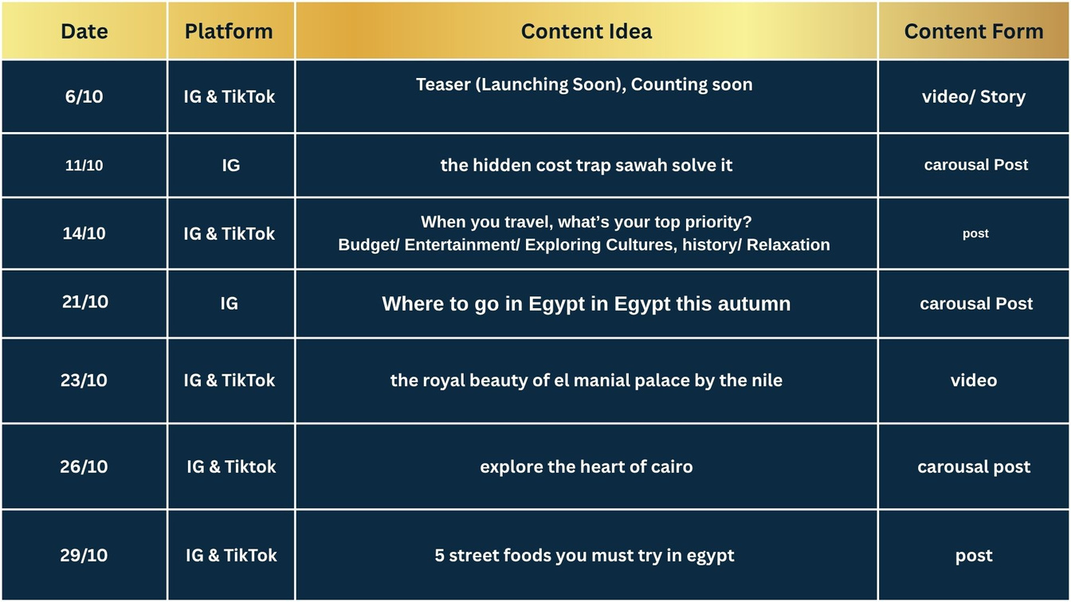
CONTENT CALENDER

Slide 25
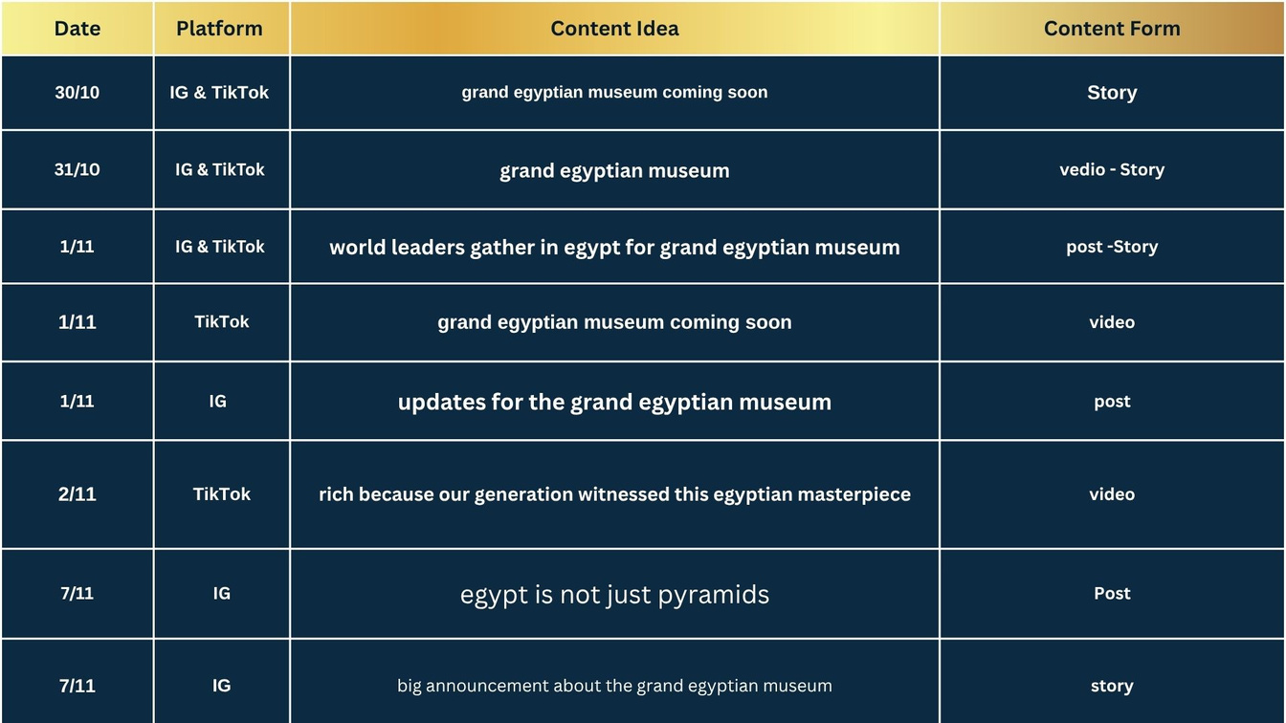
CONTENT CALENDER

Slide 26
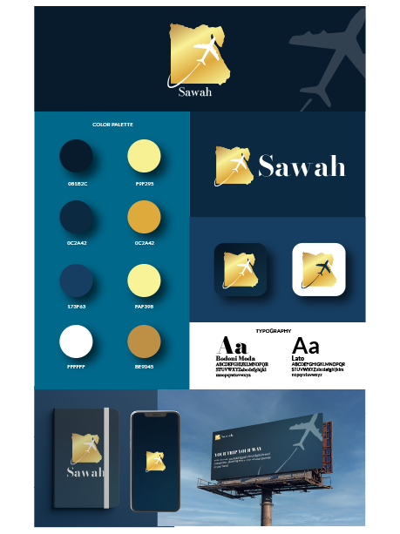
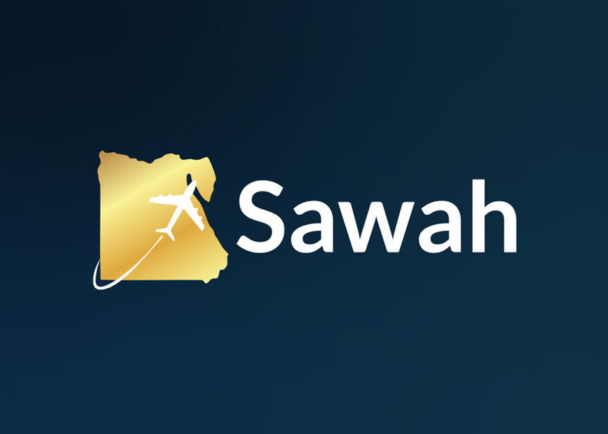
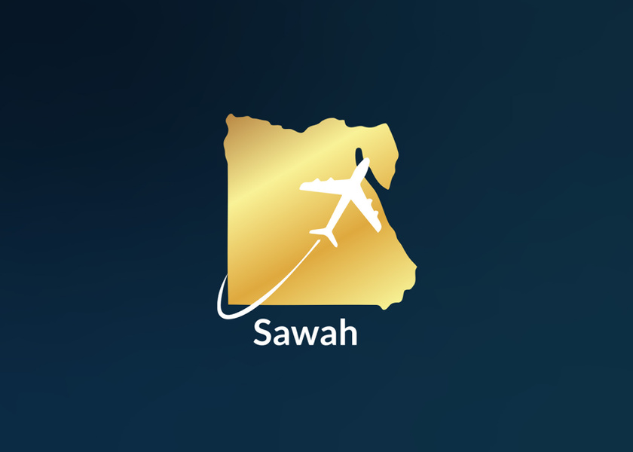
BRANDING

Slide 27
ANALYSIS REPORT

Slide 28
INSTAGRAM INSIGHTS & ANALYSIS

Slide 29
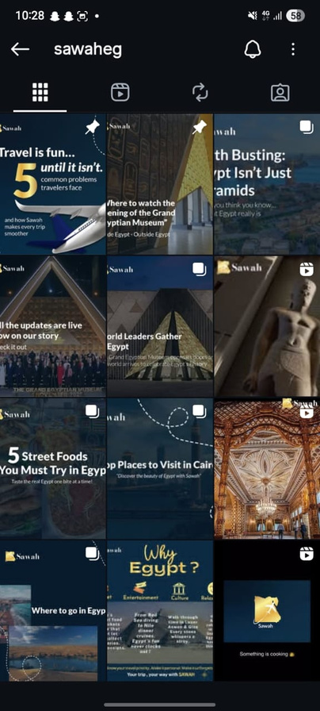

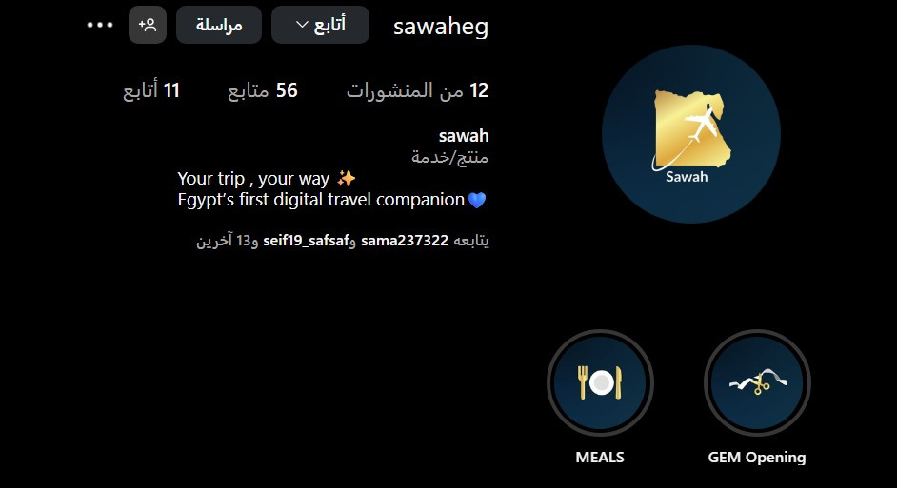
INSTGRAM
PLATFORM CHOSEN

Slide 30
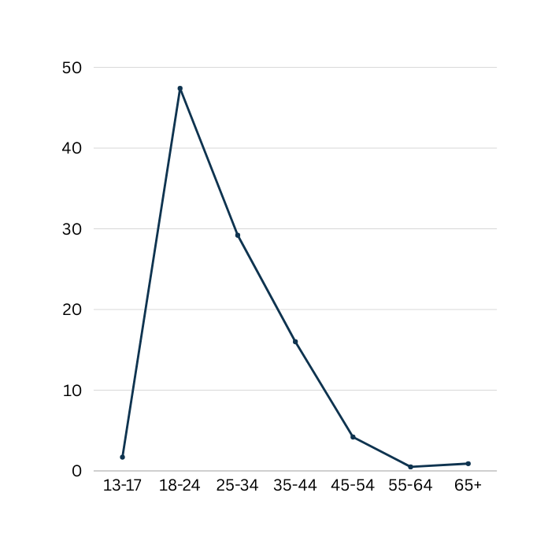
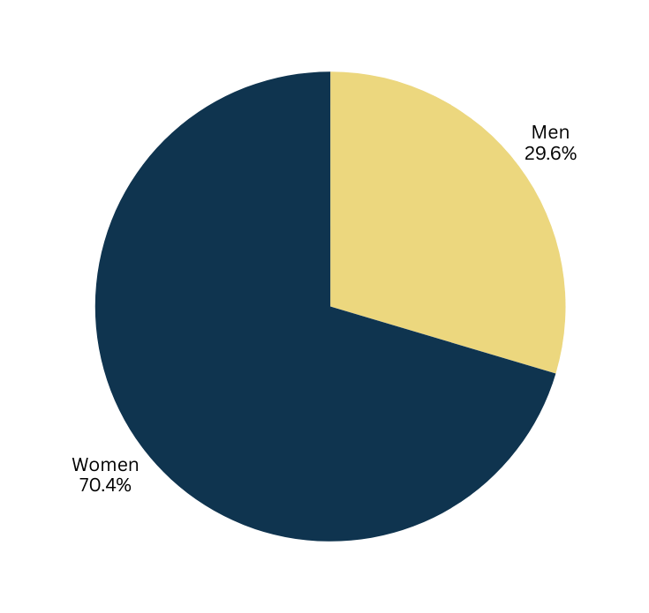
INSIGHTS ON INSTAGRAM FOLLOWERS:

Slide 31
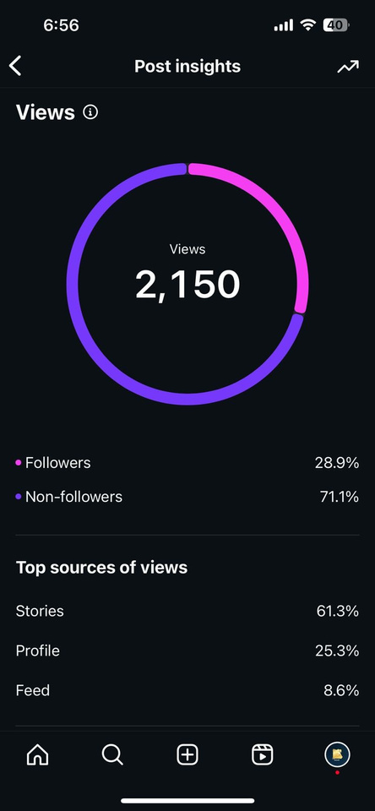
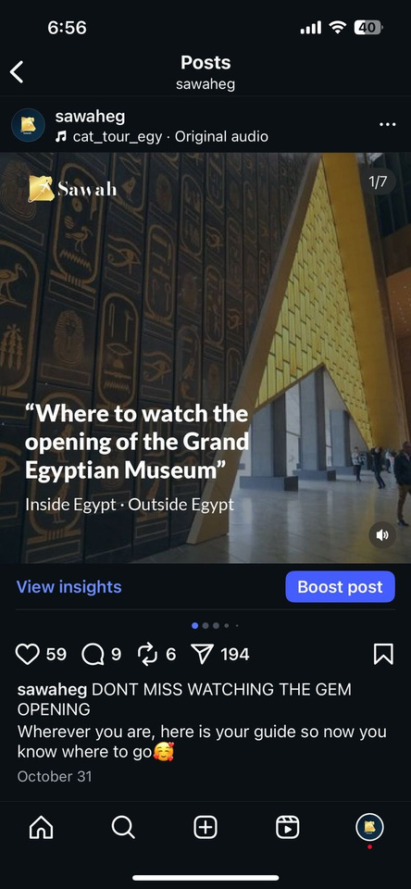
THE BEST PERFORMANCE POST ON INSTAGRAM
CONTENT TITLE: "WHERE TO WATCH THE OPENING OF THE GRAND EGYPTIAN MUSEUM.
INSIDE EGYPT • OUTSIDE EGYPT" (PHOTO CAROUSEL)

Slide 32
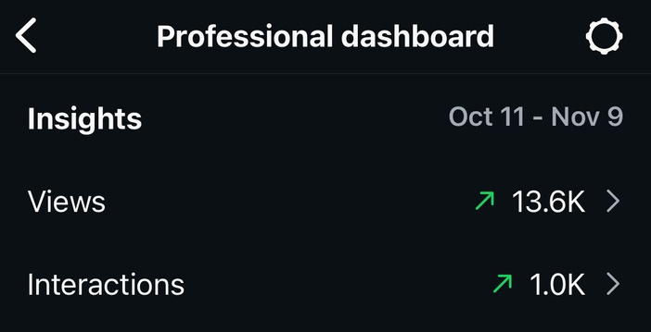
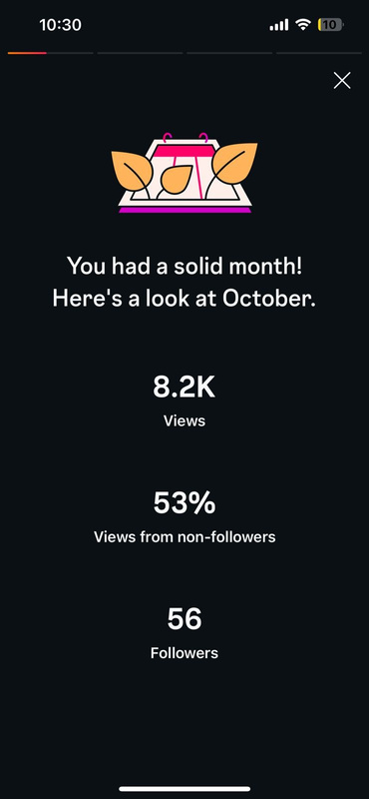
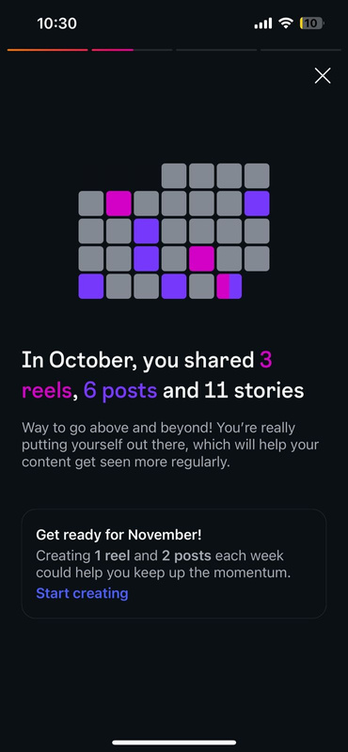
THE OVERALL INSIGHTS FOR SAWAH’S INSTAGRAM APPEARANCE IS:
ON INSTAGRAM THERE WAS A TOTAL OF 1K INTERACTIONS.
VIEWS REACHED TO 13.6K ( AND STILL IN CONTINUAL INCREASE)
FOLLOWERS WERE UNDER THE TARGET AUDIENCE SEGMENT CONSIDERING THEIR GENDER AND AGE RANGE. THEY WERE EXACTLY THE ONES WE NEEDED OUR MESSAGES TO REACH AND THEY HAVE SUCCESSFULLY REACHED THEM.

Slide 33
TIKTOK INSIGHTS AND ANALYSIS

Slide 34
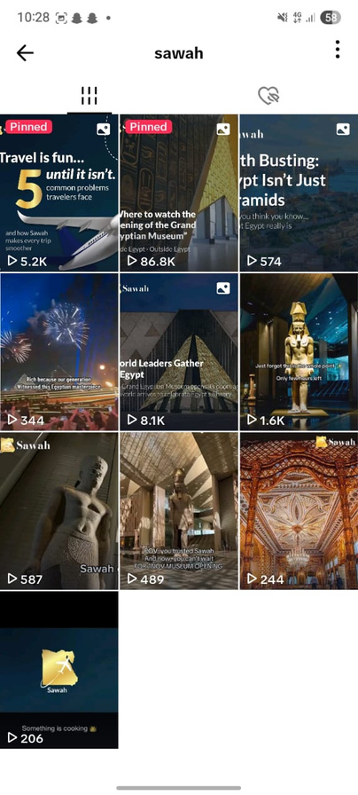

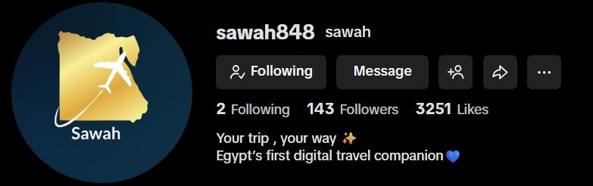
TIKTOK
PLATFORM CHOSEN

Slide 35
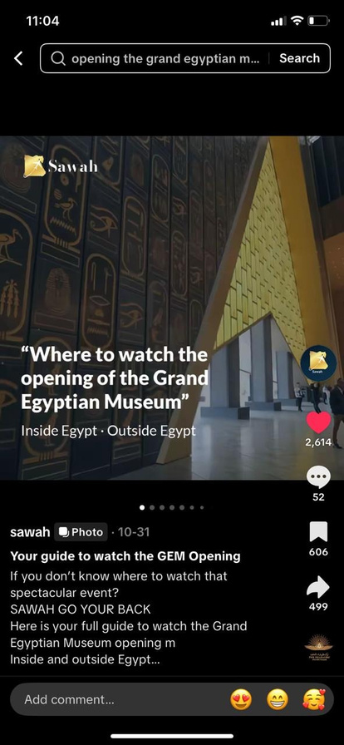
TOP PERFORMING CONTENT (ORGANIC SUCCESS)
CONTENT TITLE: "WHERE TO WATCH THE OPENING OF THE GRAND EGYPTIAN MUSEUM.
INSIDE EGYPT • OUTSIDE EGYPT" (PHOTO CAROUSEL)
KEY METRICS: VIEWS: 86,215 LIKES: 2,613 SAVES: 606 SHARES: 499

Slide 36
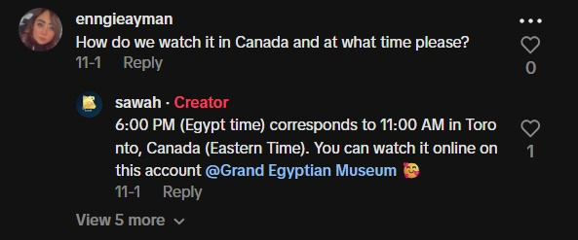
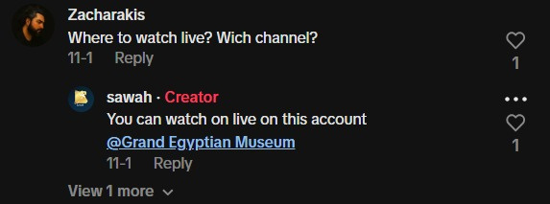
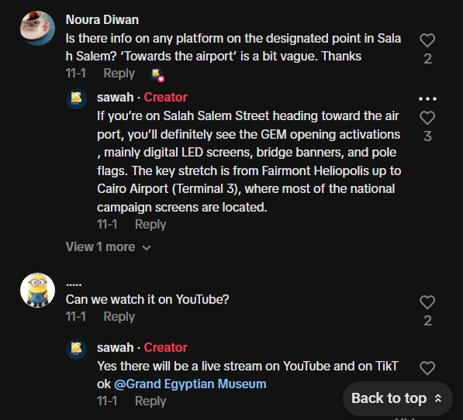
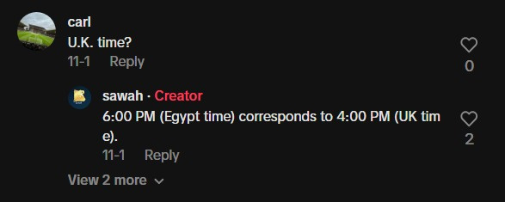
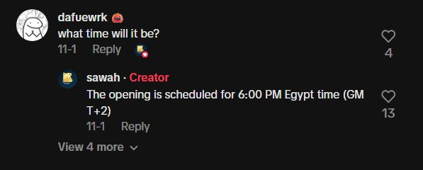
AUDIENCE & ALIGNMENT: CONNECTING GLOBALLY

Slide 37
THANK YOU

